Slide 1
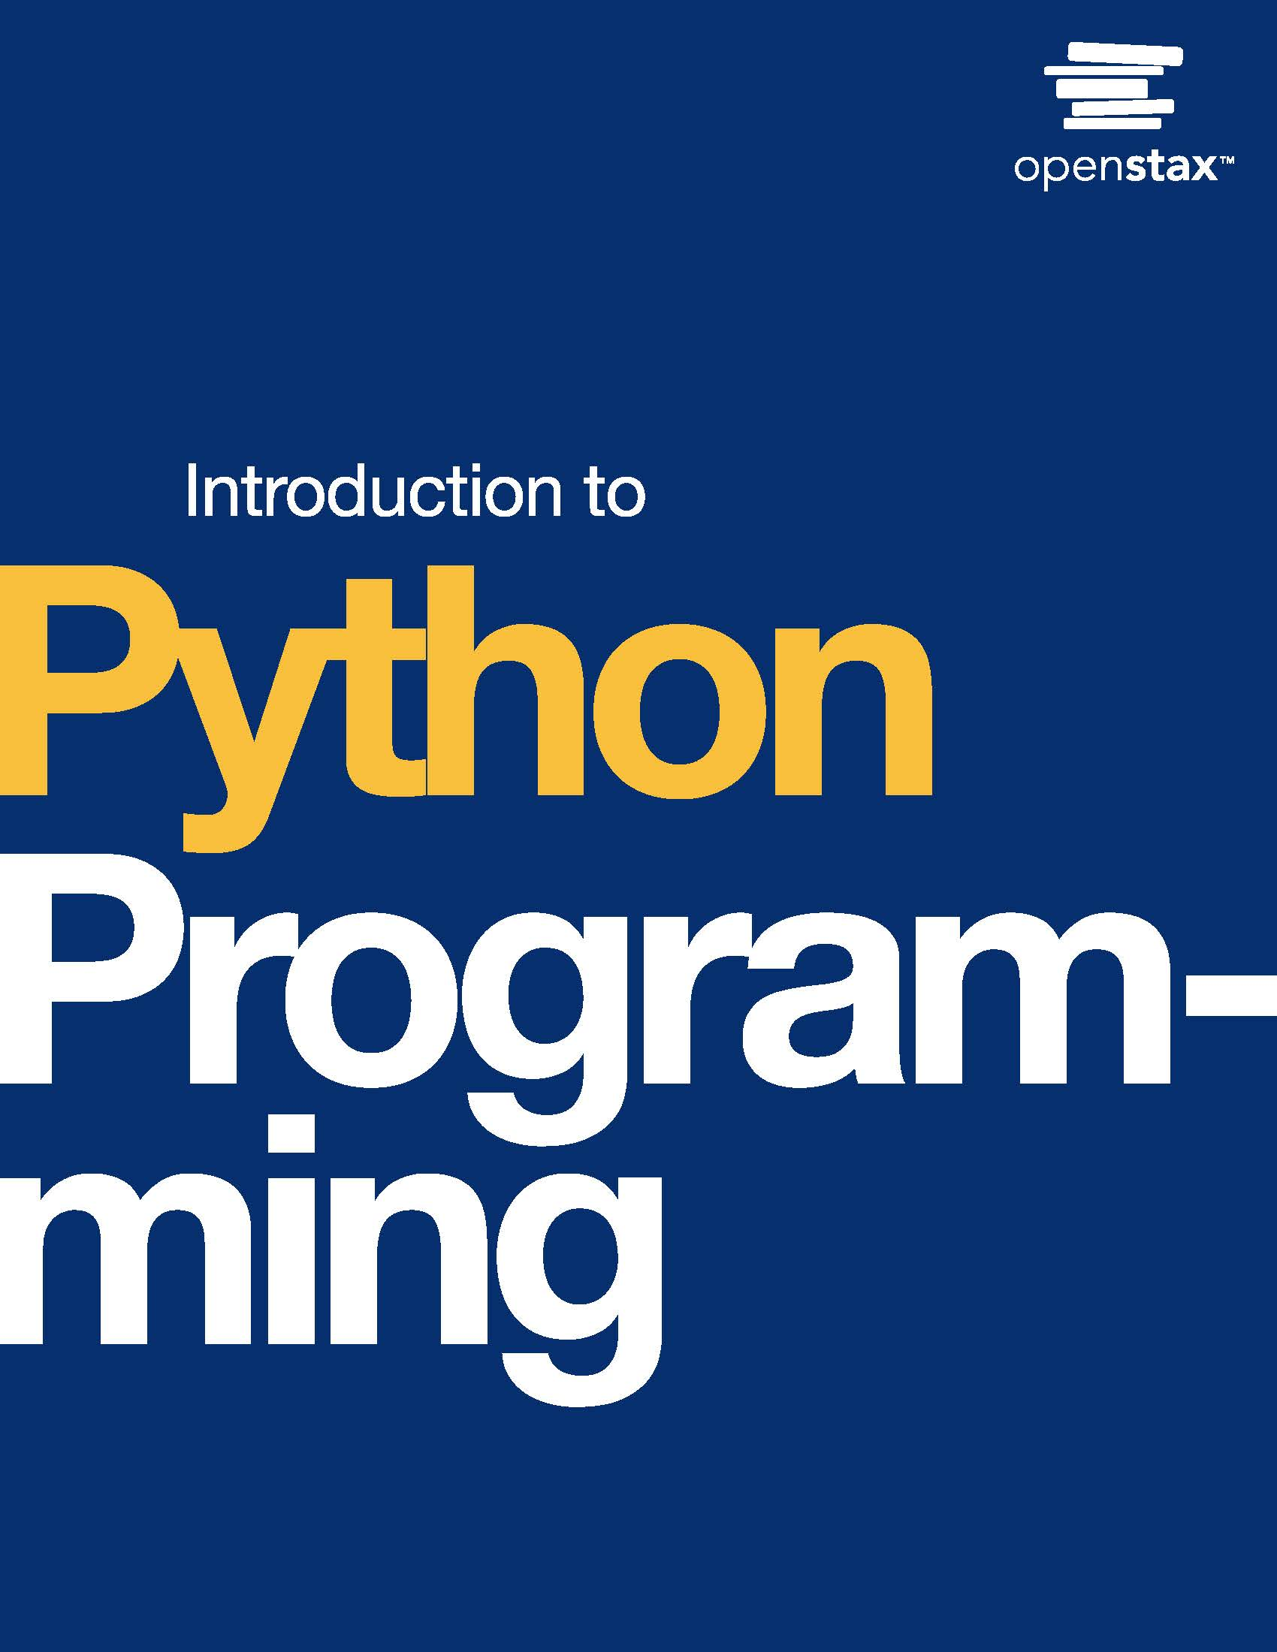
Introduction to Python Programming
Chapter 15: Data Science

Slide 2
Chapter outline
Introduction to data science
NumPy
Pandas
Exploratory data analysis
Data visualization

Slide 3
15.1 Introduction to data science
Learning Objectives
Describe data science.
Identify different stages of the data science life cycle.
Name data science tools and software.
Use Google Colaboratory to run code.

Slide 4
15.1 Introduction to data science
Data science life cycle
Data science is a multidisciplinary field that combines collecting, processing, and analyzing large volumes of data to extract insights and drive informed decision-making.
The data science life cycle is the framework followed by data scientists to complete a data science project.
Iterative process that starts with data acquisition, followed by data exploration.
The data acquisition stage may involve obtaining data from a source or collecting data through surveys and other means of data collection that are domain-specific. D
During the data exploration stage, data scientists will ensure that the data are in the right format for the data analysis stage through data cleanup and they may also visualize the data for further inspection.
The data analysis stage involves using data to generate insights or make a predictive model.

Slide 5
15.1 Introduction to data science
Data science tools
Python is widely used in data science. Large system of libraries designed for data analysis, machine learning, and visualization.
Some popular Python libraries for data science include NumPy, Pandas, Matplotlib, Seaborn, and scikit-learn. In this chapter, you will explore some of these libraries.
R is commonly used in statistical computing and data analysis, and it offers a wide range of packages and libraries tailored for data manipulation, statistical modeling, and visualization.
Jupyter Notebook and JupyterLab are web-based interactive computing environments that support multiple programming languages, including Python and R.
They allow a programmer to create documents that contain code, visualizations, and text, making them suitable for data exploration, analysis, and reporting.
Google Colaboratory is a cloud-based Jupyter Notebook environment that allows a programmer to write, run, and share Python code online. In this chapter, you will use Google Colaboratory to practice data science concepts.
Kaggle Kernels is an online data science platform that provides a collaborative environment for building and running code. Kaggle Kernels support Python and R and offers access to datasets, pre-installed libraries, and computational resources.
Microsoft Excel and Google Sheets are widely used spreadsheet applications that offer basic data analysis and visualization capabilities.

Slide 6
15.2 NumPy
Learning Objectives
Describe the NumPy library.
Create a NumPy array object.
Choose appropriate NumPy functions to process arrays of numerical data.

Slide 7
15.2 NumPy
NumPy library
NumPy (Numerical Python) is a Python library that provides support for efficient numerical operations on large, multi-dimensional arrays and serves as a fundamental building block for data analysis in Python.
The conventional alias for importing NumPy is np.
NumPy implements the ndarray object, which allows the creation of a multi-dimensional array of homogeneous data types (columns with the same data type) and efficient data processing.
An ndarray object can have any number of dimensions and can store elements of various numeric data types.

Slide 8
15.2 NumPy
To create a NumPy ndarray object, one of the following options can be used:
Creating an ndarray by converting a Python list or tuple using the np.array() function.
Using built-in functions like np.zeros() and np.ones() for creating an array of all 0's or all 1's, respectively.
Generating an array with random numbers using np.random.rand(n, m), where n and m are the number of rows and columns, respectively.
Loading data from a file. Ex: np.genfromtxt('data.csv', delimiter=',').

Slide 9
15.2 NumPy
NumPy operations
In addition to the ndarray data type, NumPy's operations provide optimized performance for large-scale computation.
The key features of NumPy include:
Mathematical operations: include arithmetic, trigonometric, exponential, and logarithmic functions.
Array manipulation: include reshaping, transposing, concatenating, splitting, and adding or removing elements from arrays.
Linear algebra operations: matrix multiplication, matrix inversion, eigenvalues, and eigenvectors.

Slide 10
15.3 Pandas
Learning Objectives
Describe the Pandas library.
Create a DataFrame and a Series object.
Choose appropriate Pandas functions to gain insight from heterogeneous data.

Slide 11
15.3 Pandas
Pandas is an open-source Python library used for data cleaning, processing, and analysis. Pandas provides data structures and data analysis tools to analyze structured data efficiently.
The name "Pandas" is derived from the term "panel data," which refers to multidimensional structured datasets. Key features of Pandas include:
Data structure: Pandas implements two main data structures:
Series: A Series is a one-dimensional labeled array.
DataFrame: A DataFrame is a two-dimensional labeled data structure that consists of columns and rows.
A DataFrame can be thought of as a spreadsheet-like data structure where each column represents a Series. DataFrame is a heterogeneous data structure where each column can have a different data type.

Slide 12
15.3 Pandas
Data processing functionality: data selection, filtering, slicing, sorting, merging, joining, and reshaping.
Integration with other libraries: Pandas integrates well with other Python libraries, such as NumPy.
The conventional alias for importing Pandas is pd. In other words, Pandas is imported as import pandas as pd. Examples of DataFrame and Series objects are shown below.

Slide 13
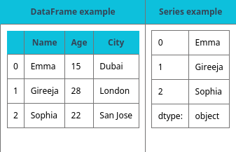
Table 15.1

Slide 14
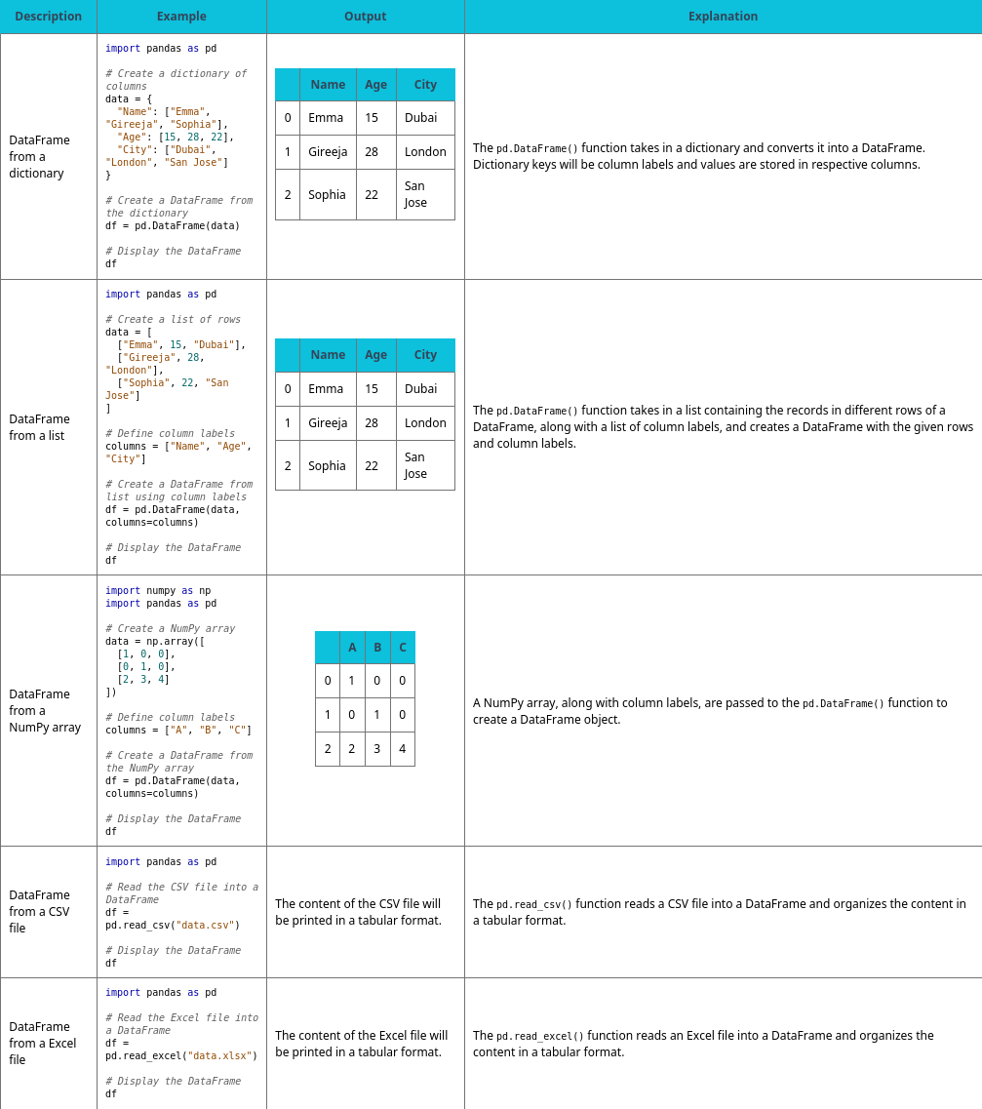
Table 15.2 DataFrame creation.

Slide 15
15.3 Pandas
Pandas for data manipulation and analysis
The Pandas library provides functions and techniques to explore, manipulate, and gain insights from the data.
Key DataFrame functions that analyze this code are described in the following table.
import pandas as pd
import numpy as np

Slide 16
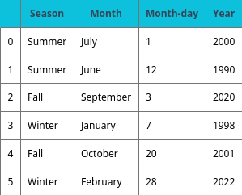
Table 15.3

Slide 17
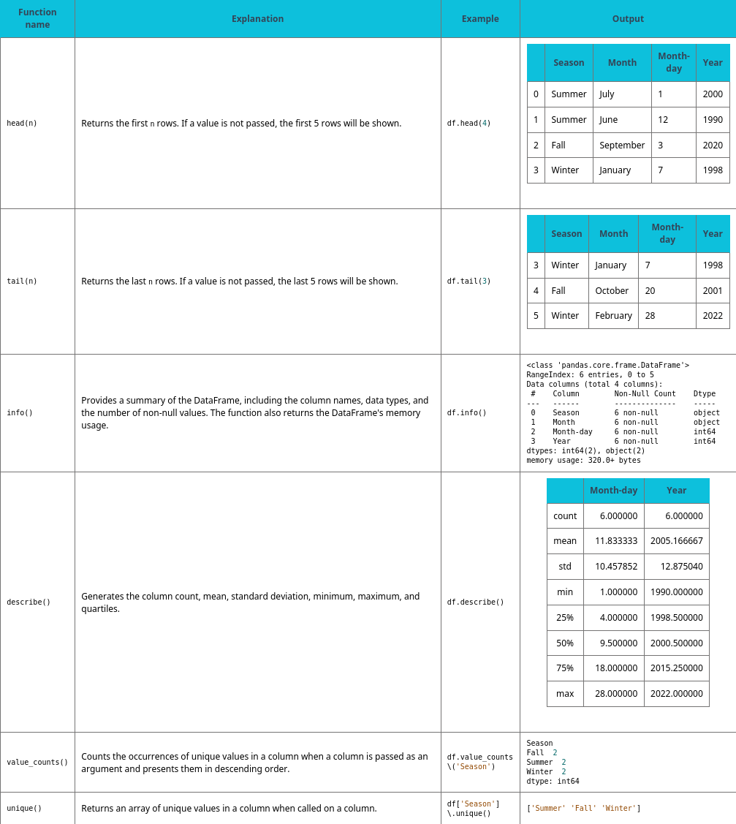
Table 15.4 DataFrame functions.

Slide 18
15.4 Exploratory data analysis
Learning Objectives
Describe exploratory data analysis.
Inspect DataFrame entries through appropriate indexing.
Use filtering and slicing to obtain a subset of a DataFrame.
Identify Null values in a DataFrame.
Remove or replace Null values in a DataFrame.

Slide 19
15.4 Exploratory data analysis
Exploratory Data Analysis (EDA) is the task of analyzing data to gain insights, identify patterns, and understand the underlying structure of the data.
During EDA, data scientists visually and statistically examine data to uncover relationships, anomalies, and trends, and to generate hypotheses for further analysis.
A feature is an individual variable or attribute that is calculated from the raw data in the dataset.

Slide 20
15.4 Exploratory data analysis
Data indexing can be used to select and access specific rows and columns. Data indexing is essential in examining a dataset.
In Pandas, two types of indexing methods exist:
Label-based indexing using loc[]: loc[] allows you to access data in a DataFrame using row/column labels.
Ex: df.loc[row_label, column_label] returns specific data at the intersection of row_label and column_label.
Integer-based indexing using iloc[]: iloc[] allows you to access data in a DataFrame using integer-based indexes.
Integer indexes can be passed to retrieve specific data.
Ex: df.iloc[row_index, column_index] returns specific data at the index row_index and column_index.

Slide 21
15.4 Exploratory data analysis
Data slicing and filtering
Data slicing and filtering involve selecting specific subsets of data based on certain conditions or index/label ranges.
Data slicing refers to selecting a subset of rows and/or columns from a DataFrame. Slicing can be performed using ranges, lists, or Boolean conditions.
Slicing using ranges:
Ex: df.loc[start_row:end_row, start_column:end_column] selects rows and columns within the specified ranges.
Slicing using a list:
Ex: df.loc[[label1, label2, ...], :] selects rows that are in the list [label1, label2, ...] and includes all columns since all columns are selected by the colon operator.
Slicing based on a condition: df[condition] selects only the rows that meet the given condition.
Data filtering involves selecting rows or columns based on certain conditions.
Ex: In the expression df[df['column_name'] > threshold], the DataFrame df is filtered using the selection operator ([]) and the condition(df['column_name'] > threshold) that is passed.
All entries in the DataFrame df where the corresponding value in the DataFrame is True will be returned.

Slide 22
15.4 Exploratory data analysis
Handling missing data
Missing values in a dataset can occur when data are not available or are not recorded properly. Identifying and removing missing values is an important step in data cleaning and preprocessing.
The functions below are useful in understanding and analyzing missing data.
isnull(): The isnull() function can be used to identify Null entries in a DataFrame. The return value of the function is a Boolean DataFrame, with the same dimensions as the original DataFrame with True values where missing values exist.
dropna(): The dropna() function can be used to drop rows with Null values.
fillna(): The fillna() function can be used to replace Null values with a provided substitute value.
Ex: df.fillna(df.mean()) replaces all Null values with the average value of the specific column.

Slide 23
15.4 Exploratory data analysis
To define a Null value in a DataFrame, you can use the np.nan value from the NumPy library.
import pandas as pd
import numpy as np
# Create sample data data = { "Column 1": ["A", "B", "C", "D", "E"], "Column 2": [np.NAN, 200, 500, 0, -10], "Column 3": [True, True, False, np.NaN, np.NaN] } df = pd.DataFrame(data)

Slide 24
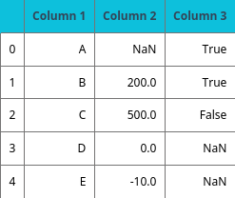
Table 15.5

Slide 25
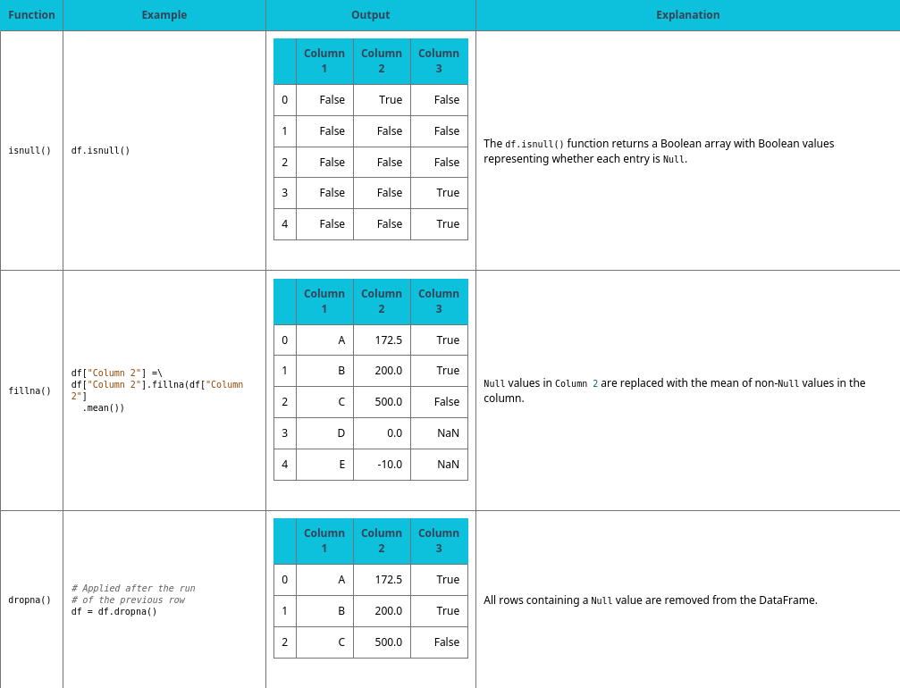
Table 15.6 Null identification and removal examples.

Slide 26
15.5 Data visualization
Learning Objectives
Explain why visualization has an important role in data science.
Choose appropriate visualization for a given task.
Use Python visualization libraries to create data visualization.

Slide 27
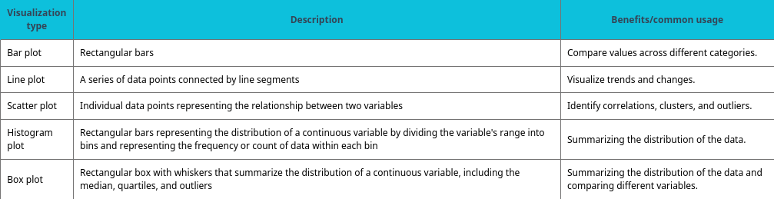
Table 15.7 Common visualization types.

Slide 28
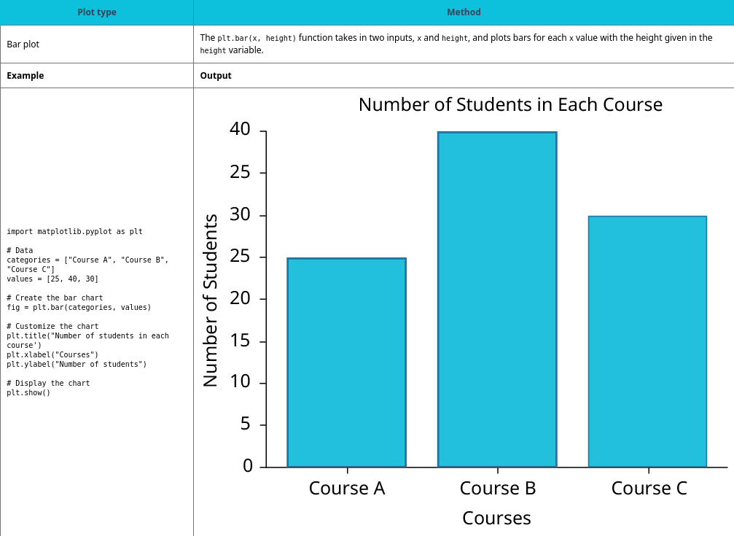
Table 15.8 Matplotlib functionalities.

Slide 29
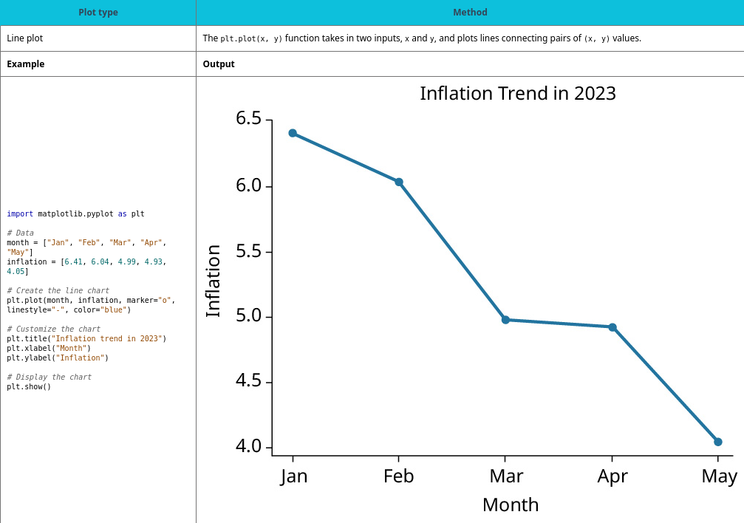
Table 15.9 Matplotlib functionalities.

Slide 30
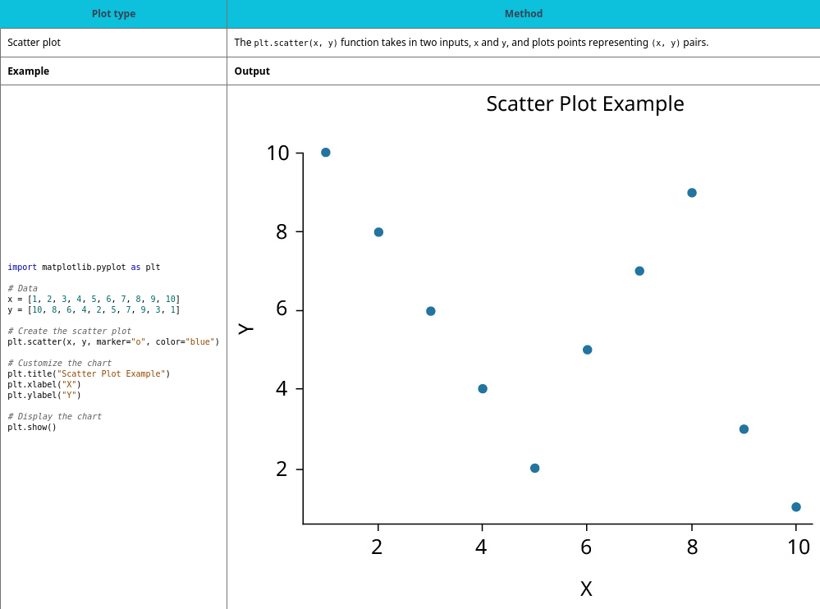
Table 15.10 Matplotlib functionalities.

Slide 31
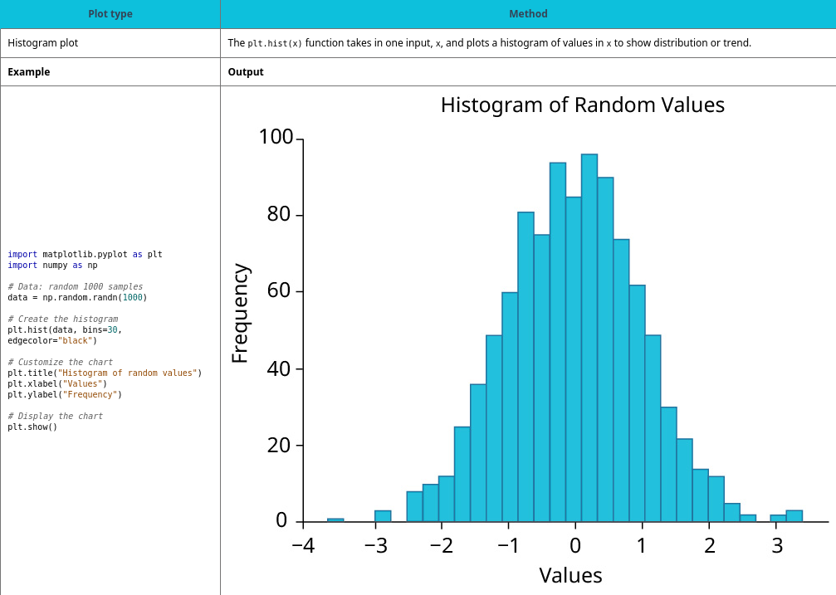
Table 15.11 Matplotlib functionalities.

Slide 32
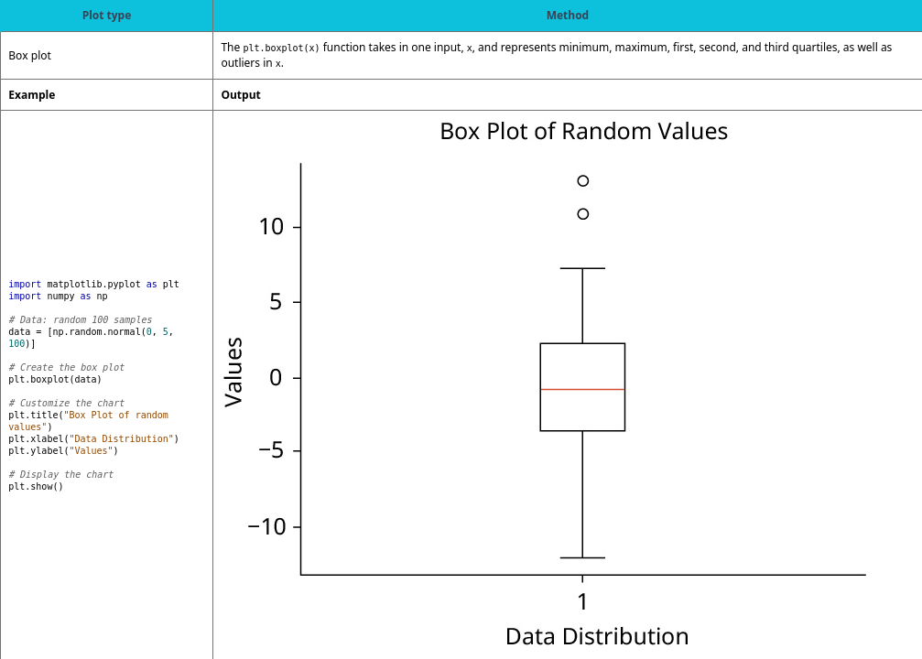
Table 15.12 Matplotlib functionalities.

Slide 33
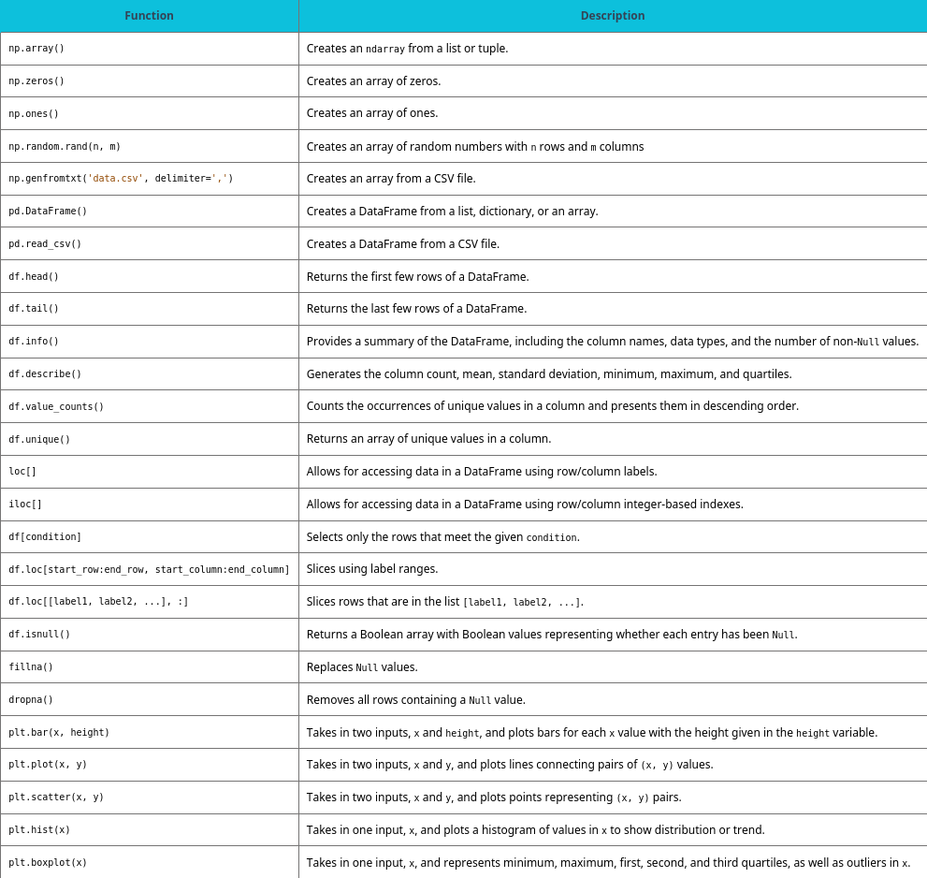
Chapter 15 reference.

Slide 34
This ancillary resource is licensed under a Creative Commons Attribution-NonCommercial-ShareAlike 4.0 (CC BY NC-SA) license; it may be distributed, remixed, built upon for noncommercial purposes only, and must be attributed to OpenStax and redistributed under the same license.

